Slide 1
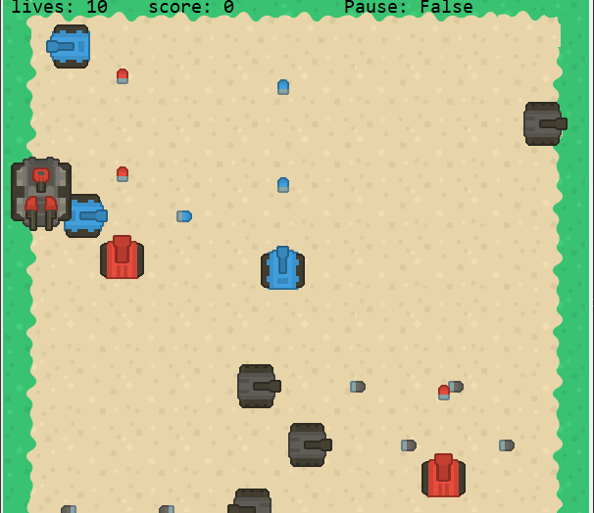
Tank War
A 2D AI Confrontation Game
Present by Xi Zhu

Slide 2
Agenda
Team Member Roles and Responsibilities
Problem Statement
Project Description
Team working agreement
Personas
MVP (Minimal Viable Product)
Technologies
Algorithms
Diagrams
Product Backlog
Sprint 1 Backlog
Test Cases
Metrics
Retrospective
Sprint 2
MVP Project Demo & GitHub link

Slide 3
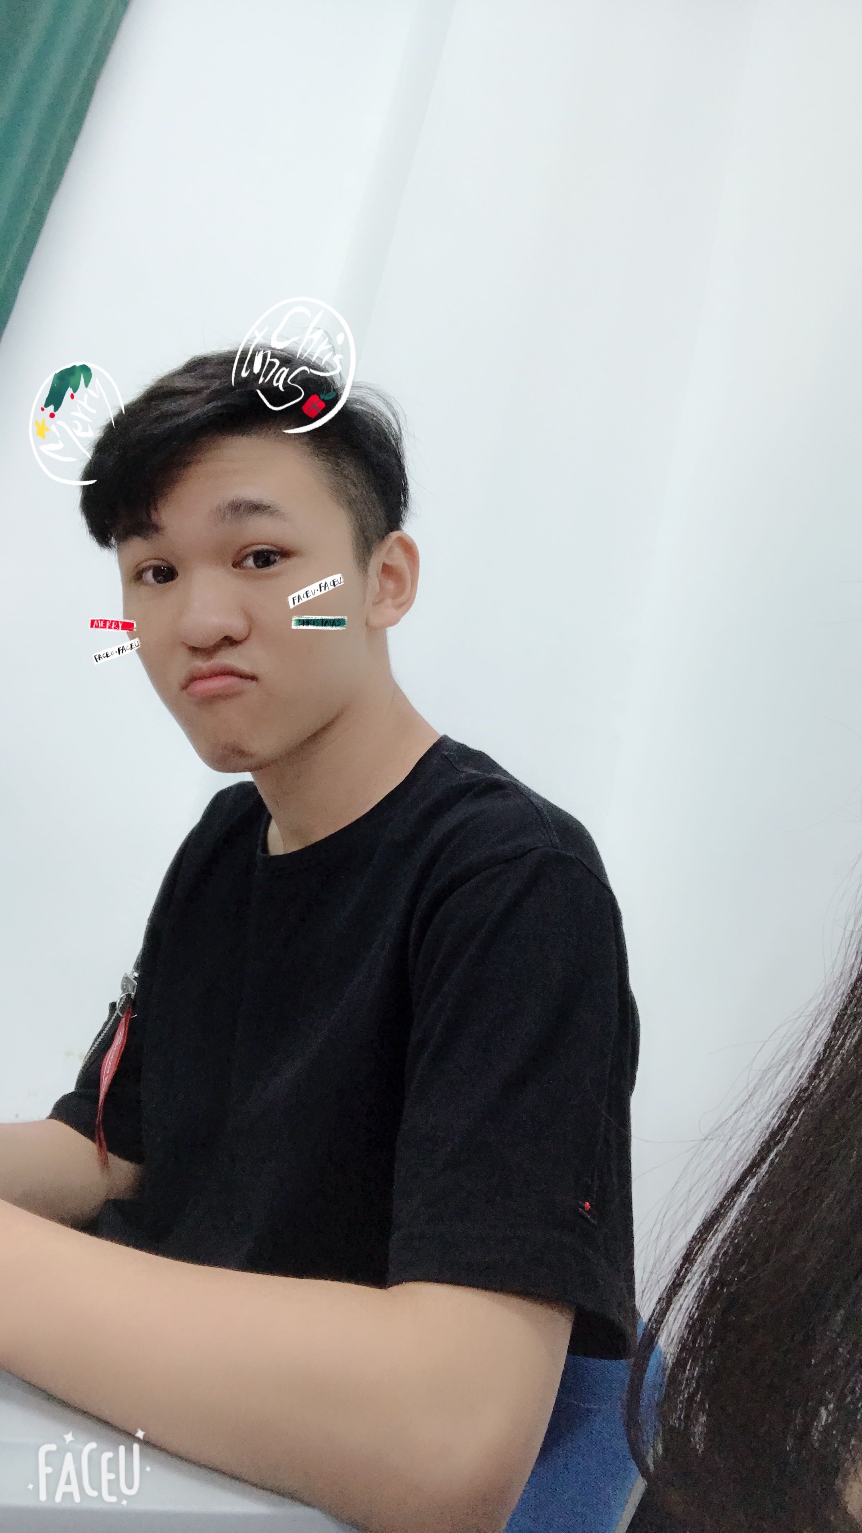
Team Member Roles and Responsibilities
Responsibilities:
Define the Product Vision and Strategy
Create a Product Roadmap
Prioritize Product Backlog
Write and Test Codes
Collect User Feedback
Measure Product Success
Xi Zhu
Product Manager

Slide 4

Problem Statement
The problems of simple playability, uneven quality, and inoperability of traditional 2D Battle Games, it is difficult for players to obtain a satisfactory game experience.

Slide 5
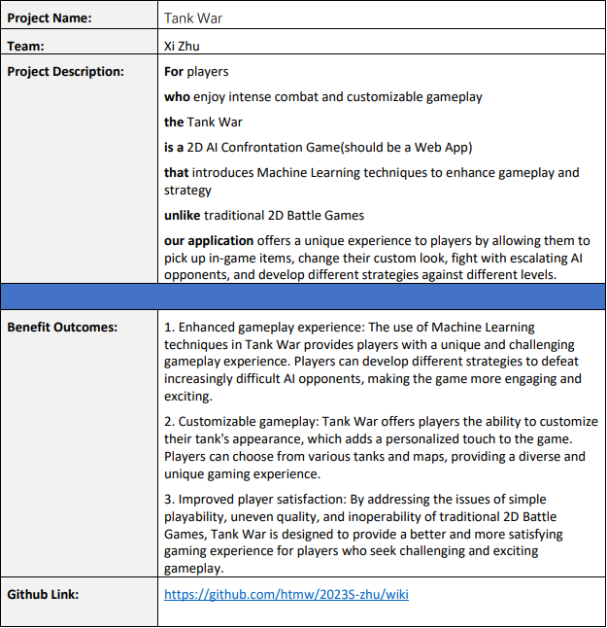
Project Description

Slide 6
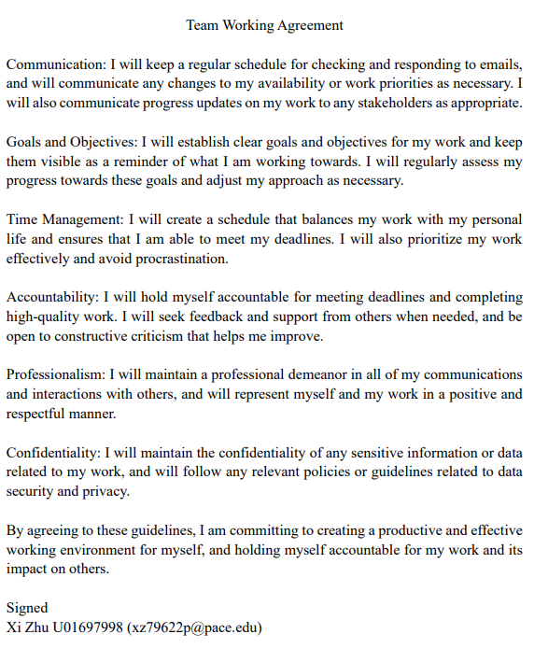
Team Working Agreement
Communication
Goals and Objectives
Time Management
Accountability
Professionalism
Confidentiality

Slide 7

Personas

Slide 8
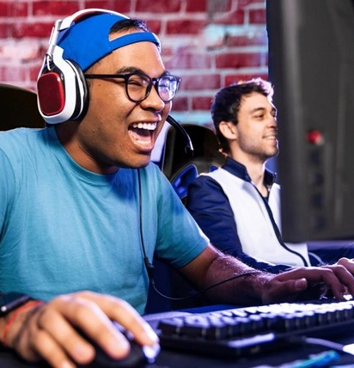
Persona 1 - Gaming Enthusiast Gary
Name: Gary Carlos
Age: 22
Job: College Student
Profile:
Gary is a 22-year-old college student who is a passionate gamer. He spends most of his free time playing video games and loves games that offer a challenging and rewarding experience.
Frustration and Goals:
Gary is frustrated with games that are too easy or lack replayability. He is always looking for new games that provide an engaging and immersive experience.
His goal is to find a game that he can play for hours on end and continue to enjoy.

Slide 9
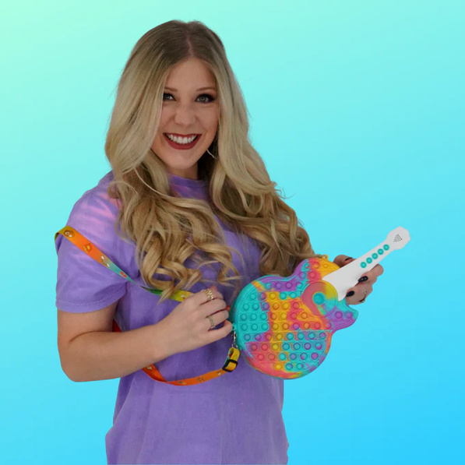
Persona 2 - Busy Bee Brianna
Name: Brianna Mary
Age: 32
Job: White-collar Employee
Profile:
Brianna is a 32-year-old working professional who enjoys playing games in her downtime. She has a busy schedule and often finds herself with limited free time.
Frustration and Goals:
Brianna is frustrated with games that require a lot of time commitment or are too complex to understand quickly.
Her goal is to find a game that she can pick up and play for short periods of time and still enjoy. She likes games that are easy to learn but still offer a challenge.

Slide 10

Persona 3 - Competitive Cam
Name: Cameron Nguyen
Age: 26
Job: Game Anchor
Profile:
Cam is a 26-year-old gamer and game anchor who loves playing competitive games. He livestreams his games on YouTube everyday.
Frustration and Goals:
Cam is frustrated with games that don't offer a fair playing field or are too easy to win.
His goal is to find a game that he can compete in at a high level and feel challenged by. He likes games that have a competitive scene and allow him to measure his skills against other players.

Slide 11
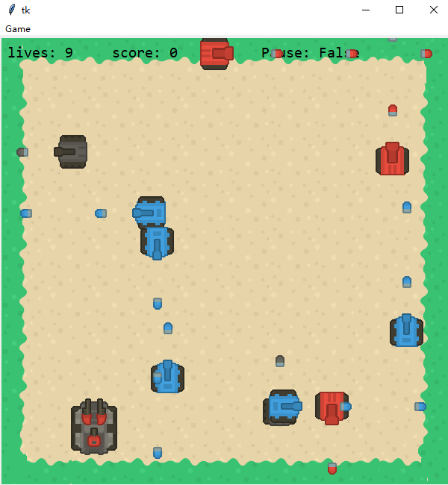
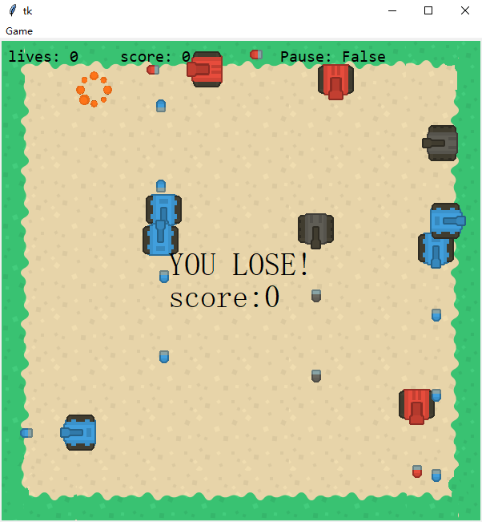
MVP (Minimal Viable Product)

Slide 12

Technology Tools

Slide 13

Diagrams

Slide 14
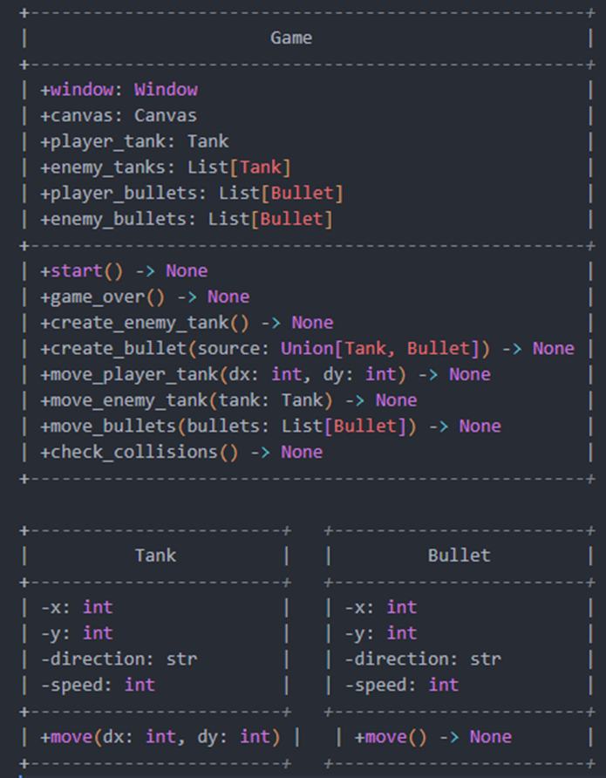
Conceptual Diagram

Slide 15
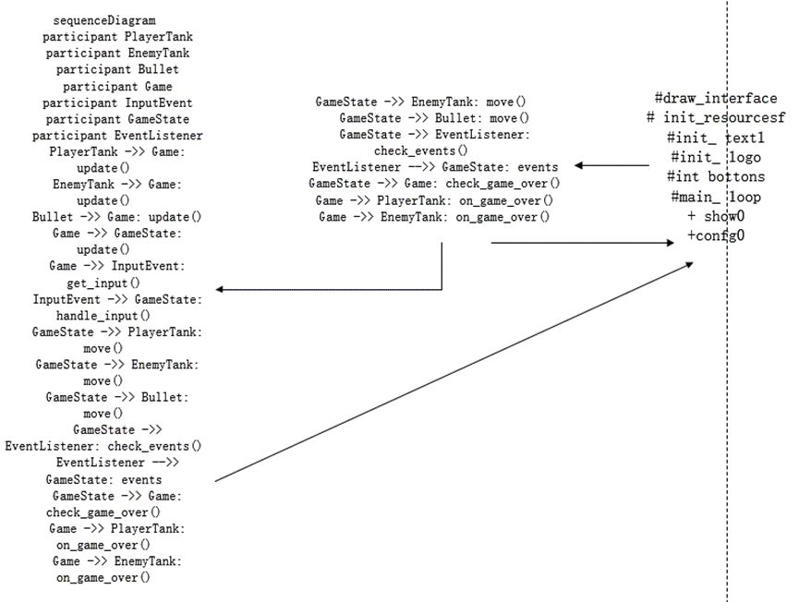
Sequence Diagram

Slide 16
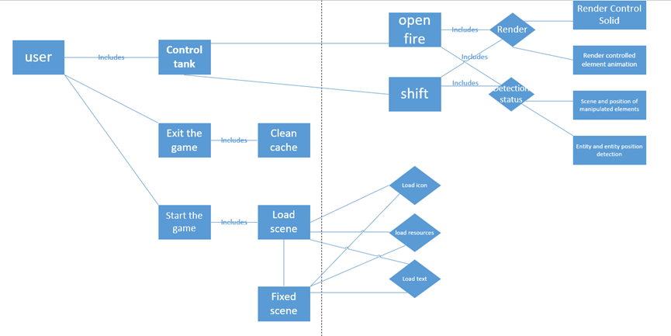
Use Case Diagram

Slide 17
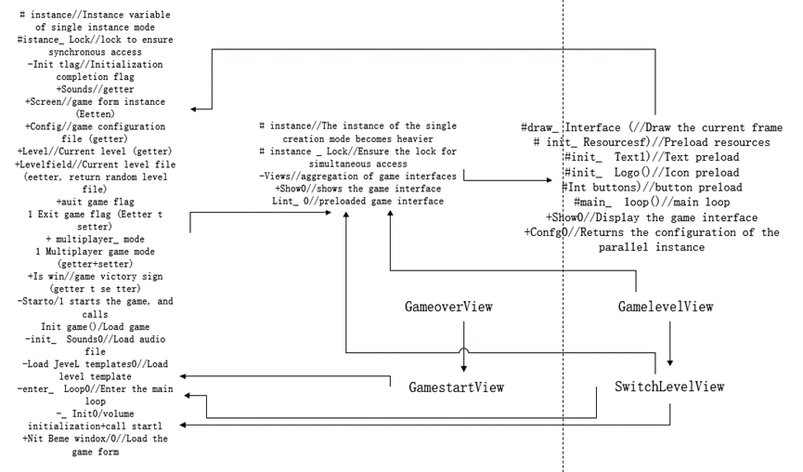
Class Diagram

Slide 18
Product Backlog
User Stories And Accecptance Crieria
ID | As a | I want to | So that | Acceptance Criteria (format: use keywords Given, When, Then) | Status | Sprint
US 1 | Player/ Customer | control a tank with a keyboard | I can move around the battlefield and engage in combat with other tanks. | Scenario: Tank Movement Given: The player is on the game screen When: The player presses the arrow keys on the keyboard to control the tank's movement Then: The tank moves in the direction of the arrow key that was pressed. | Done | 1
US 2 | Player/ Customer | fire my tank's cannon | I can destroy enemies' tanks. | Scenario: Firing the Cannon Given: The player is on the game screen When: The player presses the spacebar on the keyboard to fire the cannon Then: The tank fires a shell in the direction it is facing. | Done | 1
US 3 | Player/ Customer | have a single-player mode | I can practice my skills and strategies against AI-controlled tanks. | Scenario: Single-player mode Given: The player is on the game screen When: The player selects the Game Start option Then: The game starts in single-player mode, with AI-controlled tanks as enemies and allies. | Done | 1
US 4 | Player/ Customer | have a variety of maps to choose from | I can experience different terrains and battlefields. | Scenario: Choosing a Map Given: The player is on the game screen When: The player selects the map selection option Then: A list of available maps is displayed, and the player can select one to start the game on that map. | To be Done
US 5 | Player/ Customer | have enemies and allies | I can experince different situtations and have more fun | Scenario: Enemies and Allies Given: The player is on the game screen When: The game starts Then: Enemies and allies are present on the battlefield, and the player can differentiate between them. | Done | 1
US 6 | Player/ Customer | have a scoreboard that shows my score | I can see how many score I get. | Scenario: Scoreboard Given: The player is on the game screen When: The game is in progress Then: The scoreboard displays the player's score | Done | 1
US 7 | Player/ Customer | have multiple lives | I'm not gonna let one mistake end the game | Scenario: Multiple Lives Given: The game is in progress When: The player's tank takes damage Then: The tank loses a life, and the player can continue playing with the remaining lives. | Done | 1
US 8 | Player/ Customer | have different language options | fit my language preferences. | Scenario: Language Options Given: The player is on the game screen When: The language selection option is available Then: The player can select a language preference, and the game's language will be changed accordingly. | To be Done
US 9 | Player/ Customer | pause the game at any time | take a break or attend to other matters. | Scenario: Pausing the Game Given: The game is in progress When: The player presses the pause button Then: The game is paused, and the player can resume playing or exit the game. | To be Done
US 10 | Player/ Customer | play on different difficulty levels | I can challenge myself and get different experiences. | Scenario: Difficulty Levels Given: The player is on the game screen When: The player selects a difficulty level Then: The game's difficulty is changed, and the player experiences a different level of challenge. | To be Done

Slide 19
Product Backlog
US 11 | Player/ Customer | my shells to score differently when they hit friendly and enemy forces | affecting my strategy and scoring. | Scenario: Shell Scoring Given: The player's tank fires a shell When: The shell hits an enemy tank Then: The player scores points. If the shell hits a friendly tank, the player loses points. | To be Done
US 12 | Player/ Customer | have different kind of enemies | enrich my game experience | Scenario: Different Types of Enemies Given: The game is in progress When: The player encounters different types of enemy tanks Then: The player experiences a variety of gameplay challenges. | Done | 1
US 13 | Player/ Customer | customize my game's graphics, such as resolution and quality | I can get the best game experience | Scenario: Graphics Customization Given: The player is on the game screen When: The graphics customization option is available Then: The player can adjust the game's graphics settings, such as resolution and quality. | To be Done
US 14 | Player/ Customer | collect power-ups such as health boosts, speed boosts | I can increase my chances of survival and progress through the game. | Scenario: Power-Ups Given: The player is on the game screen When: The player collects a power-up Then: The player's tank gains a benefit, such as increased health or speed. | To be Done
US 15 | Player/ Customer | see the lives status of my tank | I can know how much damage I can sustain | Scenario: Lives Status Given: The game is in progress When: The player's tank takes damage Then: The lives status of the tank is updated to reflect the remaining health. | Done | 1
US 16 | Player/ Customer | be able to hide behind obstacles such as walls and rocks | I can avoid enemy fire and ambush them. | Scenario: Obstacle Hiding Given: The player's tank is near an obstacle, such as a wall or rock When: The player presses the hide button Then: The tank moves behind the obstacle and is hidden from enemy fire. | To be Done
US 17 | Player/ Customer | be able to customize my tank's appearance with different skins and colors | I can personalize my gameplay experience. | Scenario: Tank Skin Customization Given: The user is on the main menu When: The user selects the "customize tank" option Then: The system displays the customization options, including skins and colors And: The user can select a skin and color And: The system applies the selected skin and color to the tank | To be Done
US 18 | Player/ Customer | have access to different types of tanks with different stats, such as speed, health, and firepower | I can choose the one that suits my playstyle the best | Access to Different Types of Tanks Scenario: Tank Selection Given: The user is on the main menu When: The user selects the "choose tank" option Then: The system displays the tank options, including their stats such as speed, health, and firepower And: The user can select a tank that suits their playstyle the best And: The system applies the selected tank and its stats to the gameplay | To be Done
US 19 | Player/ Customer | want enemies and friends to respawn constantly | I can constantly encounter new situations to enrich my experience | Scenario: Enemy respawn Given: The player starts a game When: The player destroys an enemy tank Then: A new enemy tank immediately appears on the battlefield When: The player's ally tank is destroyed Then: A new ally tank immediately appears on the battlefield | Done | 1
US 20 | Player/ Customer | have access to different sound effects for different actions, such as firing a cannon or collecting a power-up | enrich my game experience | Scenario: Sound Effect Customization Given: The user is on the main menu When: The user selects the "sound options" option Then: The system displays the sound options, including different sound effects for different actions And: The user can select a sound effect for each action And: The system applies the selected sound effects to the gameplay | To be Done

Slide 20

Sprint 1 Backlog

Slide 21
Sprint 1 Backlog – Completed & Uncompleted US
Sprint 1 Completed User Stories
ID | As a | I want to | So that | Acceptance Criteria (format: use keywords Given, When, Then) | Status
US 1 | Player/ Customer | control a tank with a keyboard | I can move around the battlefield and engage in combat with other tanks. | Scenario: Tank Movement Given: The player is on the game screen When: The player presses the arrow keys on the keyboard to control the tank's movement Then: The tank moves in the direction of the arrow key that was pressed. | Completed
US 2 | Player/ Customer | fire my tank's cannon | I can destroy enemies' tanks. | Scenario: Firing the Cannon Given: The player is on the game screen When: The player presses the spacebar on the keyboard to fire the cannon Then: The tank fires a shell in the direction it is facing. | Completed
US 3 | Player/ Customer | have a single-player mode | I can practice my skills and strategies against AI-controlled tanks. | Scenario: Single-player mode Given: The player is on the game screen When: The player selects the Game Start option Then: The game starts in single-player mode, with AI-controlled tanks as enemies and allies. | Completed
US 5 | Player/ Customer | have enemies and allies | I can experince different situtations and have more fun | Scenario: Enemies and Allies Given: The player is on the game screen When: The game starts Then: Enemies and allies are present on the battlefield, and the player can differentiate between them. | Completed
US 6 | Player/ Customer | have a scoreboard that shows my score | I can see how many score I get. | Scenario: Scoreboard Given: The player is on the game screen When: The game is in progress Then: The scoreboard displays the player's score | Completed
US 7 | Player/ Customer | have multiple lives | I'm not gonna let one mistake end the game | Scenario: Multiple Lives Given: The game is in progress When: The player's tank takes damage Then: The tank loses a life, and the player can continue playing with the remaining lives. | Completed
US 12 | Player/ Customer | have different kind of enemies | enrich my game experience | Scenario: Different Types of Enemies Given: The game is in progress When: The player encounters different types of enemy tanks Then: The player experiences a variety of gameplay challenges. | Completed
US 15 | Player/ Customer | see the lives status of my tank | I can know how much damage I can sustain | Scenario: Lives Status Given: The game is in progress When: The player's tank takes damage Then: The lives status of the tank is updated to reflect the remaining health. | Completed
US 19 | Player/ Customer | want enemies and friends to respawn constantly | I can constantly encounter new situations to enrich my experience | Scenario: Enemy respawn Given: The player starts a game When: The player destroys an enemy tank Then: A new enemy tank immediately appears on the battlefield When: The player's ally tank is destroyed Then: A new ally tank immediately appears on the battlefield | Completed
US 10 | Player/ Customer | play on different difficulty levels | I can challenge myself and get different experiences. | Scenario: Difficulty Levels Given: The player is on the game screen When: The player selects a difficulty level Then: The game's difficulty is changed, and the player experiences a different level of challenge. | Not Completed
US 11 | Player/ Customer | my shells to score differently when they hit friendly and enemy forces | affecting my strategy and scoring. | Scenario: Shell Scoring Given: The player's tank fires a shell When: The shell hits an enemy tank Then: The player scores points. If the shell hits a friendly tank, the player loses points. | Not Completed

Slide 22
Sprint 1 Backlog – Test Cases
Test Cases
User Story ID | Test Description | Assumptions | Action | Actual Output | Test Result (Pass/Failed)
1 | Control the tank with arrow keys | The tank will move in the direction indicated by the arrow key | Press the four arrow keys on the keyborad | The tank dose not move | Failed
1 | Control the tank with arrow keys | The tank will move in the direction indicated by the arrow key | Press the four arrow keys on the keyborad | The tank move in the direction indicated by the arrow pad | Pass
2 | Fire tank's cannon | The player presses the spacebar on the keyboard to fire the cannon | Press the spacebar on the keyboard | Program unresponsive | Failed
2 | Fire tank's cannon | The player presses the spacebar on the keyboard to fire the cannon | Press the spacebar on the keyboard | Program unresponsive | Failed
2 | Fire tank's cannon | The player presses the spacebar on the keyboard to fire the cannon | Press the spacebar on the keyboard | Tank successfully fire the cannon | Pass
3 | The Game successfully run | The Game successfully run | Run the game in Pycharm | The Game successfully run | Pass
6 | Scoreboard | The Scoreboard successfully occur and it will change when player hits allies or enemies | Run the game and hits an friendly tank or enemy tank | The Scoreboard successfully occur and it will change when player hits allies or enemies | Pass
7 | Multiple Tank Lives | the number of lives will decrease 1 when player tank gets a hit | Run the game and hits by a friendly tank or enemy tank | The game directly end and shows "you lose" | Failed
7 | Multiple Tank Lives | the number of lives will decrease 1 when player tank gets a hit | Run the game and hits by a friendly tank or enemy tank | the number of lives will decrease 1 when player tank gets a hit | Pass
12 | Different kind of enemies | Different kind of enemies successfully occurs | Run the game | Different kind of enemies successfully occurs | Pass
19 | Enemies and allies respawn | Enemies and allies will respawn by getting hit from player's tank | Control player's tank to hit an enemy or friendly tank | Enemies and allies did not respawned | Failed
19 | Enemies and allies respawn | Enemies and allies will respawn by getting hit from player's tank | Control player's tank to hit an enemy or friendly tank | Enemies and allies respawned | Pass

Slide 23
Metrics

Slide 24
Team velocity - this sprint

Slide 26
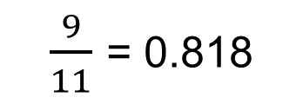
Committed/Completed Ratio
$\frac{9}{11}$ = 0.818

Slide 27
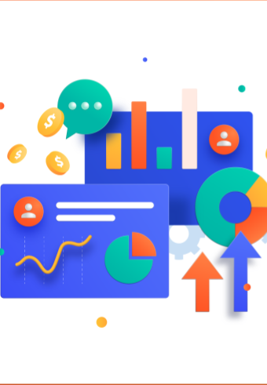
Retrospective

Slide 28
What Went Well
81% of the planned tasks Completed
The roadmap for this sprint was created and executed successfully
MVP (Minimal Viable Product) was successfully created

Slide 29
What can be improved?
The commitment to completing all the planned tasks needs to be increased, as the 19% of tasks that were not completed may have caused delays in future sprints.
We need to improve our time management skills, as some tasks took longer than expected, which may have impacted other tasks in the sprint.
Better planning is needed, such as breaking down tasks into smaller, more manageable parts, and estimating more accurately how long each task will take.

Slide 30
Next Steps
Spend some time planning sprint 2's roadmap
Finish the tasks left in sprint 1
Complete all the tasks of sprint 2
Optimized project UI

Slide 31
Sprint 2 Backlog
Sprint 2 Backlog
ID | As a | I want to | So that | Acceptance Criteria (format: use keywords Given, When, Then) | Status | Sprint
US 4 | Player/ Customer | have a variety of maps to choose from | I can experience different terrains and battlefields. | Scenario: Choosing a Map Given: The player is on the game screen When: The player selects the map selection option Then: A list of available maps is displayed, and the player can select one to start the game on that map. | To be Done | 2
US 8 | Player/ Customer | have different language options | fit my language preferences. | Scenario: Language Options Given: The player is on the game screen When: The language selection option is available Then: The player can select a language preference, and the game's language will be changed accordingly. | To be Done | 2
US 9 | Player/ Customer | pause the game at any time | take a break or attend to other matters. | Scenario: Pausing the Game Given: The game is in progress When: The player presses the pause button Then: The game is paused, and the player can resume playing or exit the game. | To be Done | 2
US 10 | Player/ Customer | play on different difficulty levels | I can challenge myself and get different experiences. | Scenario: Difficulty Levels Given: The player is on the game screen When: The player selects a difficulty level Then: The game's difficulty is changed, and the player experiences a different level of challenge. | To be Done | 2
US 11 | Player/ Customer | my shells to score differently when they hit friendly and enemy forces | affecting my strategy and scoring. | Scenario: Shell Scoring Given: The player's tank fires a shell When: The shell hits an enemy tank Then: The player scores points. If the shell hits a friendly tank, the player loses points. | To be Done | 2
US 13 | Player/ Customer | customize my game's graphics, such as resolution and quality | I can get the best game experience | Scenario: Graphics Customization Given: The player is on the game screen When: The graphics customization option is available Then: The player can adjust the game's graphics settings, such as resolution and quality. | To be Done | 2
US 14 | Player/ Customer | collect power-ups such as health boosts, speed boosts | I can increase my chances of survival and progress through the game. | Scenario: Power-Ups Given: The player is on the game screen When: The player collects a power-up Then: The player's tank gains a benefit, such as increased health or speed. | To be Done | 2
US 16 | Player/ Customer | be able to hide behind obstacles such as walls and rocks | I can avoid enemy fire and ambush them. | Scenario: Obstacle Hiding Given: The player's tank is near an obstacle, such as a wall or rock When: The player presses the hide button Then: The tank moves behind the obstacle and is hidden from enemy fire. | To be Done | 2
US 17 | Player/ Customer | be able to customize my tank's appearance with different skins and colors | I can personalize my gameplay experience. | Scenario: Tank Skin Customization Given: The user is on the main menu When: The user selects the "customize tank" option Then: The system displays the customization options, including skins and colors And: The user can select a skin and color And: The system applies the selected skin and color to the tank | To be Done | 2
US 18 | Player/ Customer | have access to different types of tanks with different stats, such as speed, health, and firepower | I can choose the one that suits my playstyle the best | Access to Different Types of Tanks Scenario: Tank Selection Given: The user is on the main menu When: The user selects the "choose tank" option Then: The system displays the tank options, including their stats such as speed, health, and firepower And: The user can select a tank that suits their playstyle the best And: The system applies the selected tank and its stats to the gameplay | To be Done | 2
US 20 | Player/ Customer | have access to different sound effects for different actions, such as firing a cannon or collecting a power-up | enrich my game experience | Scenario: Sound Effect Customization Given: The user is on the main menu When: The user selects the "sound options" option Then: The system displays the sound options, including different sound effects for different actions And: The user can select a sound effect for each action And: The system applies the selected sound effects to the gameplay | To be Done | 2

Slide 32
MVP Project Demo

Slide 33
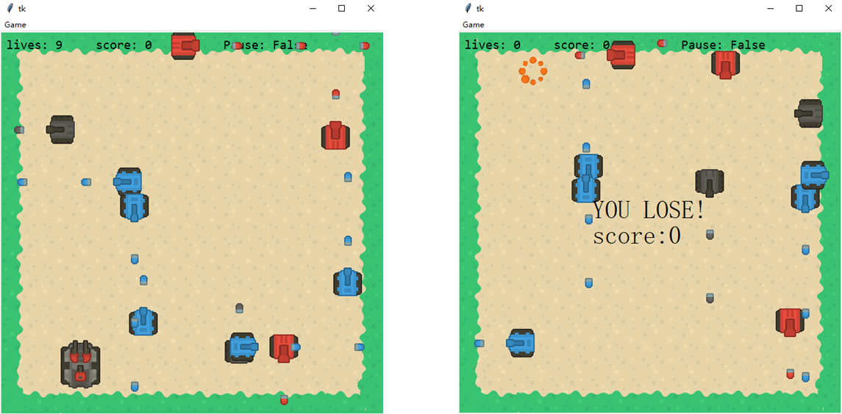
Slides App Screenshot

Slide 34
Thanks
GitHub link: https://github.com/htmw/2023S-zhu/wiki Live Application Demo: https://youtu.be/GmpB100vSpg

